Slide 1

ADVANCED ALGORITHMS

Slide 2

ADVANCED ALGORITHMS
BASICS OF COMPLEXITY

Slide 3
ADVANCED ALGORITHMS
BASICS OF COMPLEXITY
Solving Recurrence Relations: Recurrence Tree Method
In this method, we draw a recurrence tree and calculate the time taken by every level of the tree.
Finally compute the sum of the work done at all levels.
Tree is drawn until a pattern among all levels is found.
The pattern is typically an arithmetic or geometric series.

Slide 4
ADVANCED ALGORITHMS
BASICS OF COMPLEXITY
1.Solve the recurrence relation using Recurrence Tree Method
T(n) = 2T(n/2) + n
n
n
n/2
n/2
T(n/2)
T(n/2)
T(n/4)
T(n/4)
T(n/4)
T(n/4)

Slide 5
ADVANCED ALGORITHMS
BASICS OF COMPLEXITY
Solve the recurrence relation using Recurrence Tree Method
T(n) = 2T(n/2) + n
n
n/2
n/2
n/4
n/4
n/4
n/4
T(n/8)
T(n/8)
T(n/8)
T(n/8)
T(n/8)
T(n/8)
T(n/8)
T(n/8)
At Level 0 cost=n
At level 1 cost = n/2 + n/2 = n
At level 2 cost = n/4 + n/4 + n/4 + n/4 =n
T(n) = n + n + n + n….. log₂ n times
T(n) ∈ O(n log₂ n)

Slide 6
ADVANCED ALGORITHMS
BASICS OF COMPLEXITY
2. Solve the recurrence relation using Recurrence Tree Method
T(n) = T(n/5) + T(4n/5) + n
n
n
n/5
4n/5
T(n/5)
T(4n/5)
T(n/5²)
T(4n/5²)
T(4n/5²)
T(4²n/5²)
Cost at each level is n
T(n) = n + n + n + n….. Log_{5/4} n times
T(n) ∈ O(n log_{5/4} n)

Slide 7
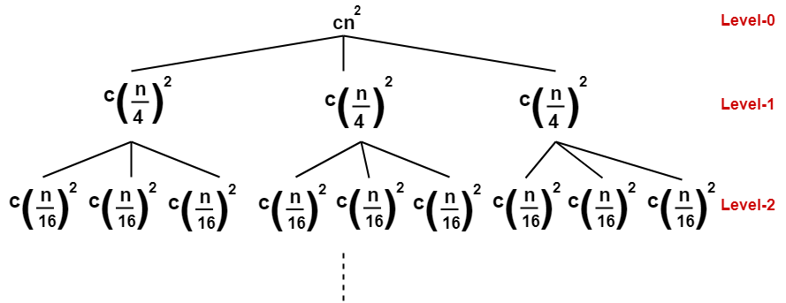
ADVANCED ALGORITHMS
BASICS OF COMPLEXITY
3. Solve the recurrence relation using Recurrence Tree Method
T(n) = 3T(n/4) + c n²

Slide 8
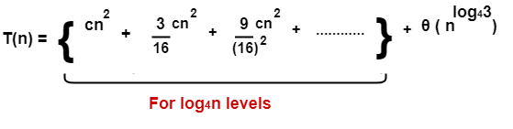
ADVANCED ALGORITHMS
BASICS OF COMPLEXITY
Determine cost of each level-
Cost at level-0 = cn²
Cost at level-1 = c(n/4)² + c(n/4)² + c(n/4)² = (3/16)cn²
Cost at level-2 = c(n/16)² x 9 = (9/16²)cn²
Determine total number of levels in the recursion tree-
Size of sub-problem at level-0 = n/4⁰
Size of sub-problem at level-1 = n/4¹
Size of sub-problem at level-2 = n/4²

Slide 9
ADVANCED ALGORITHMS
BASICS OF COMPLEXITY
On solving, we get-
= (16/13)cn² { 1 – (3/16)^{log}₄^{n} }
= (16/13)cn² – (16/13)cn² (3/16)^{log}₄^{n}
= O(n²)

Slide 10
ADVANCED ALGORITHMS
BASICS OF COMPLEXITY
4. Solve the recurrence relation using Recurrence Tree Method
T(n) = T(n/4) + T(n/2) + c n²
cn²
cn²
cn²/16
cn²/4
T(n/4)
T(n/2)
T(n/16)
T(n/8)
T(n/8)
T(n/4)

Slide 11
ADVANCED ALGORITHMS
BASICS OF COMPLEXITY
Solve the recurrence relation using Recurrence Tree Method
T(n) = T(n/4) + T(n/2) + c n²
cn²/16
cn²/4
cn²/256
cn²/64
cn²/64
cn²/16
At Level 0 cost=cn²
At level 1 cost = cn²/16 + cn²/4 = 5n²/16
At level 2 cost =cn²/256 + cn²/64 + cn²/64 + cn²/16 =25n²/256
The above series is a geometric progression with ratio 5/16
T(n)=n²/(1-5/16)
T(n) ∈ O(n²)

Slide 12
ADVANCED ALGORITHMS
BASICS OF COMPLEXITY
5. Solve the recurrence relation using Recurrence Tree Method
T(n) = 2T(n/2) + n²
n²
n²
n²/4
n²/4
T(n/2)
T(n/2)
T(n/8)
T(n/8)
T(n/8)
T(n/8)

Slide 13
ADVANCED ALGORITHMS
BASICS OF COMPLEXITY
Solve the recurrence relation using Recurrence Tree Method
T(n) = 2T(n/2) + n²
n²
n²/4
n²/4
n²/16
n²/16
n²/16
n²/16
At Level 0 cost=n²
At level 1 cost = n²/4 + cn²/4 = n²/2
At level 2 cost =n²/16 + n²/16 + n²/16 + n²/16 =n²/4
T(n)=n²/(1-1/2)
T(n) ∈ O(n²)

Slide 14
ADVANCED ALGORITHMS
BASICS OF COMPLEXITY
6. Solve the recurrence relation using Recurrence Tree Method
T(n) = T(n/3) + T(2n/3) + n
n
n
n/3
2n/3
T(n/3)
T(2n/3)
(n/9)
(2n/9)
(n/9)
(2n/9)
Cost at each level is n
T(n) = n + n + n + n….. log_{3/2} n times
T(n) ∈ O(n log_{3/2} n)

Slide 15
ADVANCED ALGORITHMS
BASICS OF COMPLEXITY
Solving Recurrence Relations: Master Method
Master method provides bounds for recurrences of the form
T(n) = aT(n/b) + f(n)
where a≥1, b>1 and f(n) is some function outside recursion.
Recurrence of this form is common when algorithm is designed using Divide and Conquer Strategy.
The above relation is the characteristic of a divide and conquer algorithm that creates ‘a’ sub-problems each of which is of size ‘b’ and f(n) is the time to combine the solutions of sub-problems

Slide 16
ADVANCED ALGORITHMS
BASICS OF COMPLEXITY
Solving Recurrence Relations: Master Method
Master method provides bounds for recurrences of the form
T(n) = aT(n/b) + f(n)
where a≥1, b>1 and f(n) is some function.
1. If f(n) = Θ(n^{c}) where c < log_{b}a then T(n) = Θ(n^{log}_{b}ª)
2. If f(n) = Θ(n^{c} log^{k}n) where c = log_{b}a then T(n) = Θ(n^{c}log^{k+1} n)
3. If f(n) = Θ(n^{c}) where c > log_{b}a then T(n) = Θ(f(n))

Slide 17
ADVANCED ALGORITHMS
BASICS OF COMPLEXITY
Solve the recurrence relation using Master Method
T(n)=9T(n/3) + n
f(n) = Θ(n^{c}) c=1
a=9, b=3
log _{b} a = log ₃ 9=2
c< log _{b} a : case 1
T(n) = Θ(n ^{log} _{b} ª )
T(n) = Θ(n²)

Slide 18
ADVANCED ALGORITHMS
BASICS OF COMPLEXITY
2. Solve the recurrence relation using Master Method
T(n)=T(2n/3) + 1
f(n) = Θ(n^{c}) c=0
a=1, b=3/2
log _{b} a = log _{3/2} 1=0
c = log _{b} a : case 2
T(n) = Θ(n^{c} log^{k+1} n )
T(n) = Θ(log n)

Slide 19
ADVANCED ALGORITHMS
BASICS OF COMPLEXITY
3. Solve the recurrence relation using Master Method
T(n)=4T(n/2) + n³
f(n) = Θ(n³) c=3
a=4, b=2
log _{b} a = log ₂ 4=2
c > log _{b} a : case 3
T(n) = Θ(f(n) )
T(n) = Θ(n³)

Slide 20
ADVANCED ALGORITHMS
BASICS OF COMPLEXITY
4. Solve the recurrence relation using Master Method
T(n)=4T(n/2) + n
f(n) = Θ(n^{c}) c=1
a=4, b=2
log _{b} a = log ₂ 4=2
c< log _{b} a : case 1
T(n) = Θ(n ^{log} _{b} ª )
T(n) = Θ(n²)

Slide 21
ADVANCED ALGORITHMS
BASICS OF COMPLEXITY
5. Solve the recurrence relation using Master Method
T(n)=4T(n/2) + n²
f(n) = Θ(n^{c}) c=2
a=4, b=2
log _{b} a = log ₂ 4=2
c = log _{b} a : case 2
T(n) = Θ(n^{c} log n )
T(n) = Θ(n²log n)

Slide 22
ADVANCED ALGORITHMS
BASICS OF COMPLEXITY
6. Solve the recurrence relation using Master Method
T(n)=3T(n/3) + (n)^{1/2}
f(n) = Θ(n^{c}) c=1/2
a=3, b=3
log _{b} a = log ₃ 3=1
c< log _{b} a : case 1
T(n) = Θ(n ^{log} _{b} ª )
T(n) = Θ(n¹)

Slide 23
ADVANCED ALGORITHMS
BASICS OF COMPLEXITY
7. Solve the recurrence relation using Master Method
T(n)=7T(n/3) + n²
f(n) = Θ(n²) c=2
a=7, b=3
log _{b} a = log ₃ 7 >1
c > log _{b} a : case 3
T(n) = Θ(f(n) )
T(n) = Θ(n²)

